Slide 1
LIVE Class - 10

Slide 2
Topics
Regression
Evaluation Metrics
Linear Regression
Polynomial Regression

Slide 3
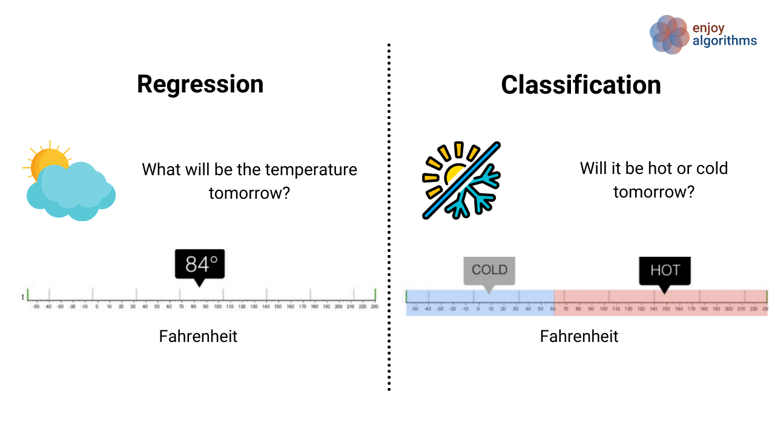
Regression
Regression is the task of predicting a continuous quantity.
Classification is the task of predicting a discrete class label.

Slide 4
Evaluation Metrics
Evaluation metrics are used to measure the quality of the statistical or machine learning model. Evaluating machine learning models or algorithms is essential for any project. Regression
Mean squared error
Root Mean Squared Error
Mean absolute error
R-squared
Adjusted R²
Classification
Classification Accuracy
Confusion Matrix
Area Under ROC Curve

Slide 5
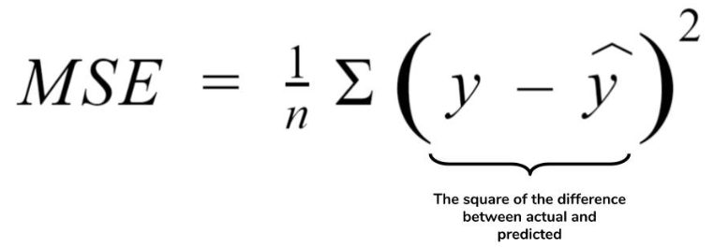
Mean squared error
MSE or Mean Squared Error is one of the most preferred metrics for regression tasks. It is simply the average of the squared difference between the target value and the value predicted by the regression model. As it squares the differences, it penalizes even a small error which leads to over-estimation of how bad the model is. It is preferred more than other metrics because it is differentiable and hence can be optimized better.

Slide 6
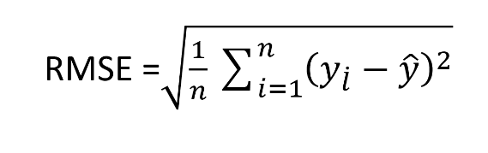
Root Mean Squared Error
RMSE is the most widely used metric for regression tasks and is the square root of the averaged squared difference between the target value and the value predicted by the model. When assessing how well a model fits a dataset, we use the RMSE more often because it is measured in the same units as the response variable.

Slide 7
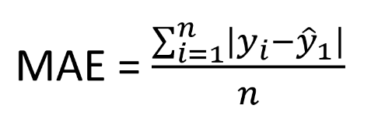
Mean absolute error
MAE is the absolute difference between the target value and the value predicted by the model. The MAE is more robust to outliers and does not penalize the errors as extremely as MSE. MAE is a linear score which means all the individual differences are weighted equally. It is not suitable for applications where you want to pay more attention to the outliers.

Slide 8
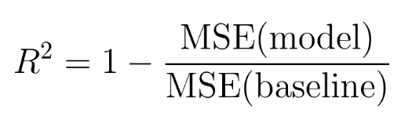
R-squared
Coefficient of Determination or R² is another metric used for evaluating the performance of a regression model. The metric helps us to compare our current model with a constant baseline and tells us how much our model is better. The constant baseline is chosen by taking the mean of the data and drawing a line at the mean. R² is a scale-free score that implies it doesn't matter whether the values are too large or too small, the R² will always be less than or equal to 1.

Slide 9
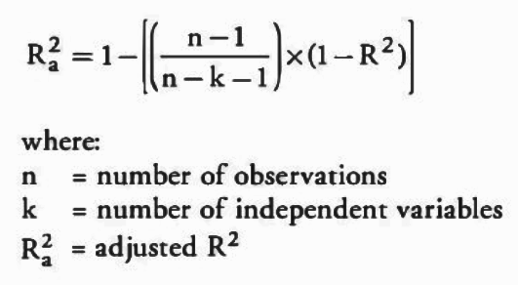
Adjusted R²
Adjusted R² depicts the same meaning as R² but is an improvement of it. R² suffers from the problem that the scores improve on increasing terms even though the model is not improving which may misguide the researcher. Adjusted R² is always lower than R² as it adjusts for the increasing predictors and only shows improvement if there is a real improvement.

Slide 10
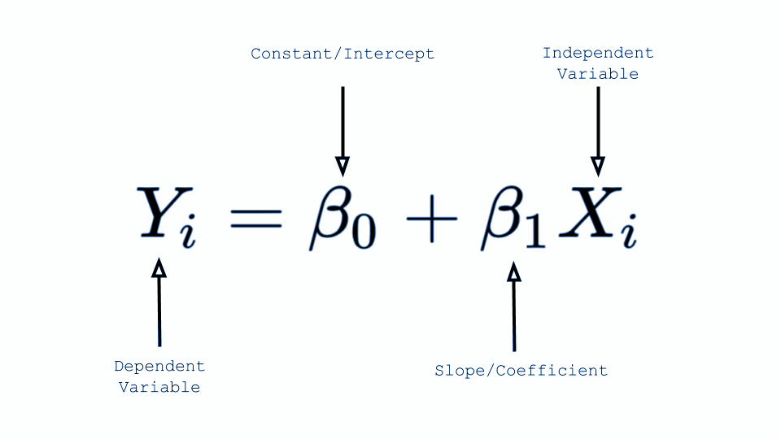
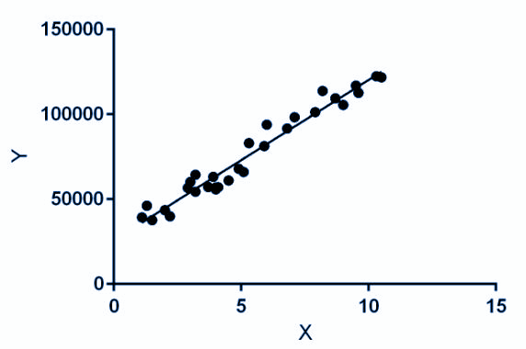
Linear Regression
Hypothesis Behind Linear Regression:
The dependent variable Y has a linear relationship to the independent variable X.
Data always follows Normal Distribution.

Slide 11
Polynomial regression
Assumptions of Polynomial Regression :
The behavior of a dependent variable y can be explained by a linear, or curvilinear, additive relationship between the dependent variable and a set of k independent variables (xi , i=1 to k)),
The relationship between the dependent variable y and any independent variable xi is linear or curvilinear (specifically polynomial),
The independent variables xi are independent of each other

Slide 12
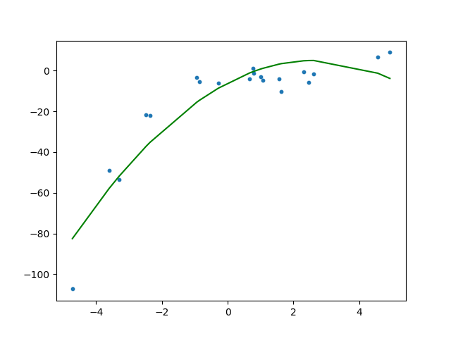
Polynomial regression
The linear model, linear regression,
Can be transformed to,
This is still considered to be linear model as the coefficients/weights associated with the features are still linear. x² is only a feature.

Slide 13
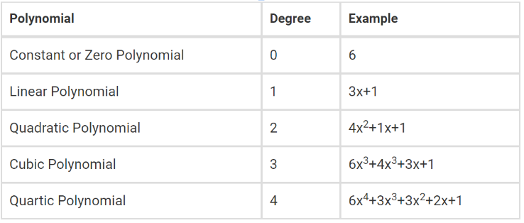
Polynomial regression
Degree of a Polynomial :
The degree of a polynomials is defined as the highest degree of a monomial within a polynomial. Thus, a polynomial equation having one variable which has the largest exponent is called a degree of the polynomial.

Slide 14
Assignment
Dataset link : https://www.kaggle.com/datasets/mirichoi0218/insurance
Do visualization and analysis to understand the dataset
Follow kaggle code for inspiration:
https://www.kaggle.com/code/trisha12/regression-random-forest-and-boosting-model
Apply polynomial regression to predict & test

Slide 15
Thank You

